Slide 1

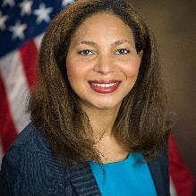
NOT SEEING THE FOREST FOR THE TREES – UNDERSTANDING ILLEGAL LOGGING AND THE BIGGER RULE OF LAW PICTURE
Transboundary impacts & collaboration to address climate emergencies; pollution; biodiversity & wildlife crime; resources; or substances of concern
Laurie Dubriel – Senior Counsel
U.S. Department of Justice, Environment and Natural Resources Division

Slide 2
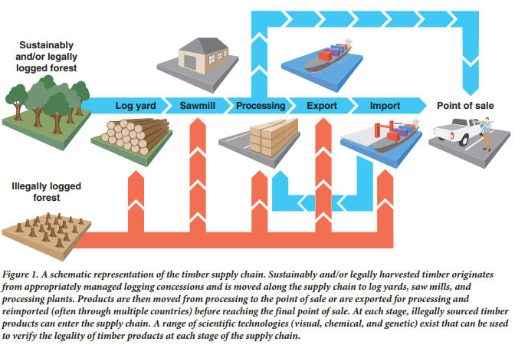

https://www.apec.org/docs/default-source/groups/egilat/15_sce3_017_zcommon-understanding-of-scope-of-ilat.docx
Opportunities for Improved Transparency in the Timber Trade through Scientific Verification
Andrew J. Lowe, Eleanor E. Dormontt, Matthew J. Bowie, Bernd Degen, Shelley Gardner, Darren Thomas, Caitlin Clarke, Anto Rimbawanto, Alex Wiedenhoeft, Yafang Yin, Nophea Saski
November 2016; BioScience 66(11):990-998

Slide 3
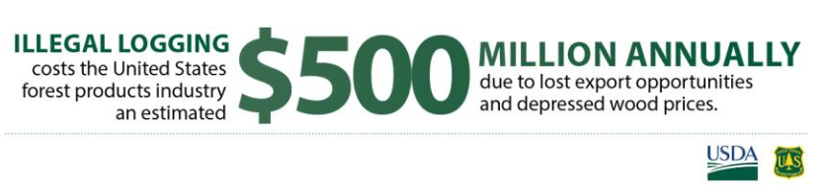
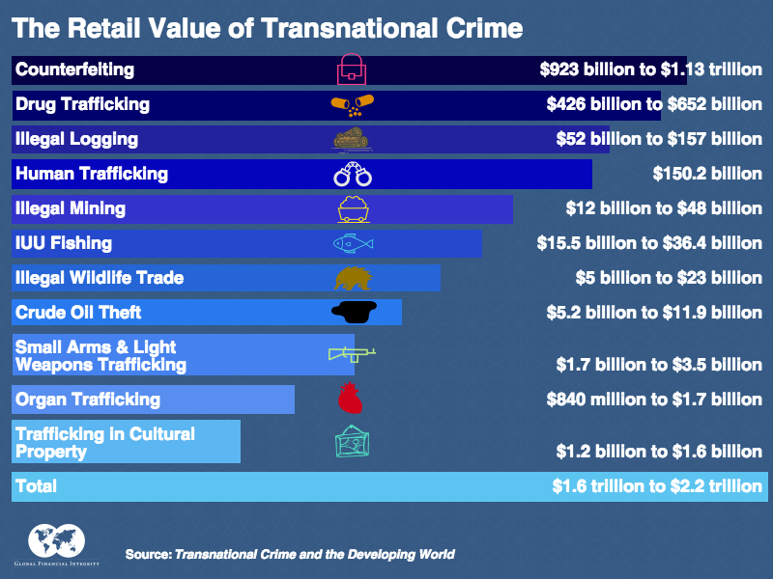
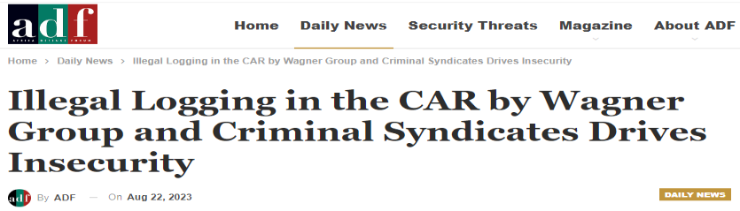
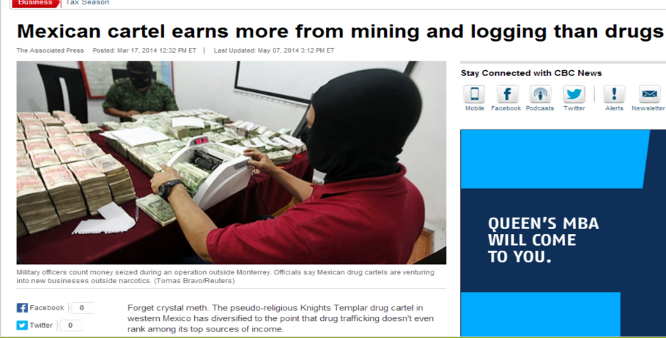
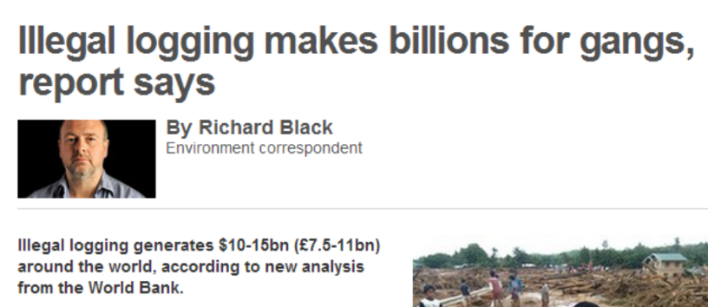
Scale of the Issue

Slide 4
Holistic Approach to Combat Illegal Logging
Money Laundering & Corruption
Transnational Organized Crime
Illegal Logging & Associated Trade
Other Natural Resource Crimes
Implementation of 2008 Lacey Act Amendments
Trade Agreements
Capacity Building & Outreach
Enforcement

Slide 5
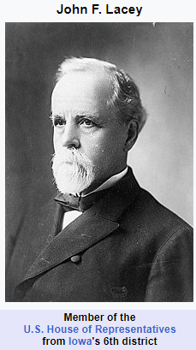

Lacey Act
Executive Orders
  14008 – Tackling the Climate Crisis at Home and Abroad
  14060 – Establishing the US Council on TOC
  14072 – Strengthening the Nation’s Forests, Communities, and Local Economies
Two Most Common Charges
  Trafficking
  False Labeling

Slide 6
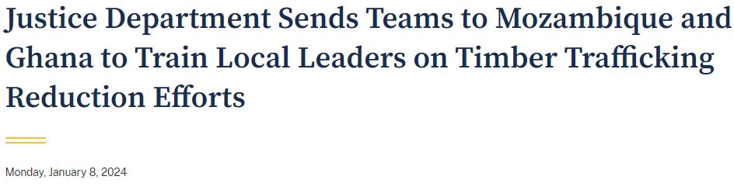
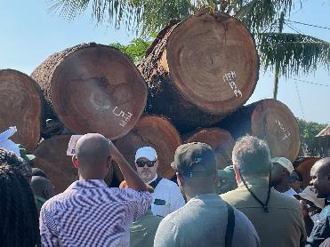
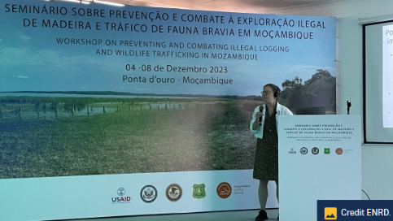
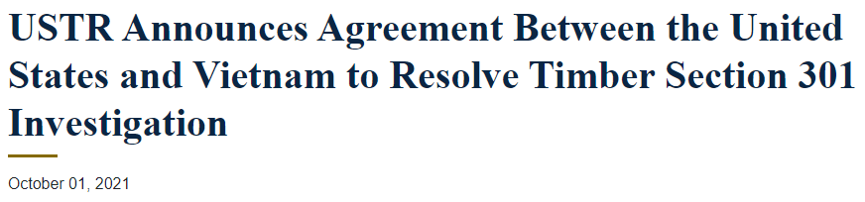
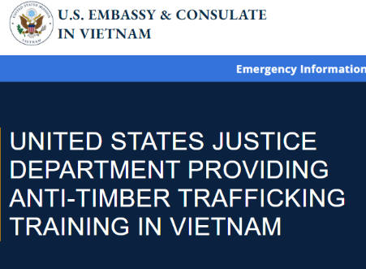

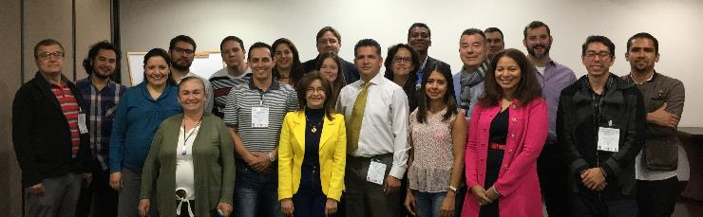
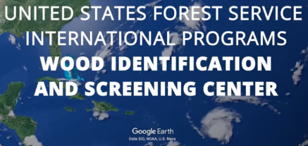
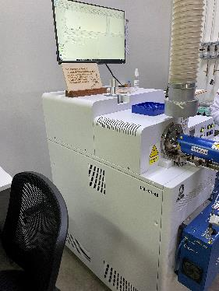



Trade & Capacity Building

Slide 7

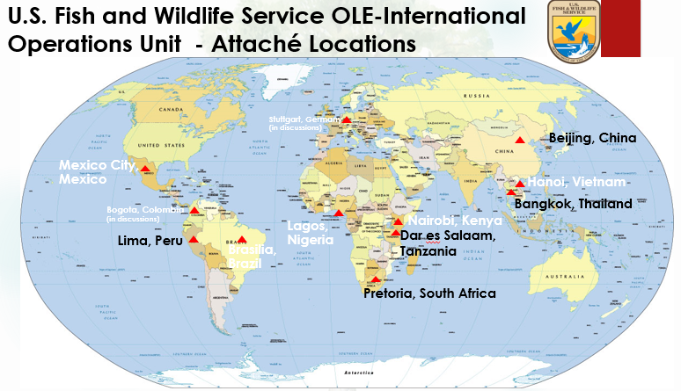
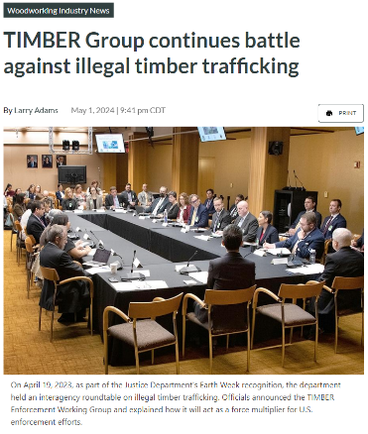
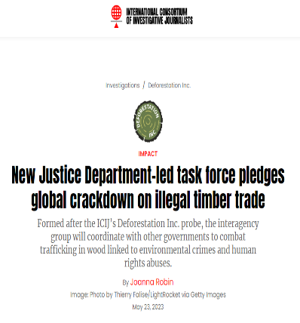


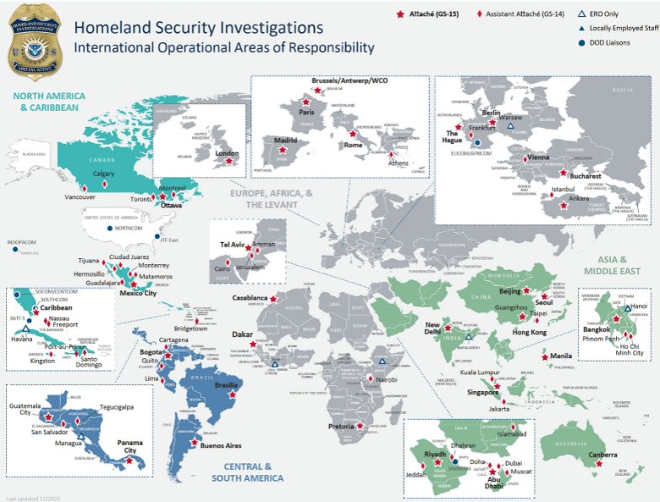
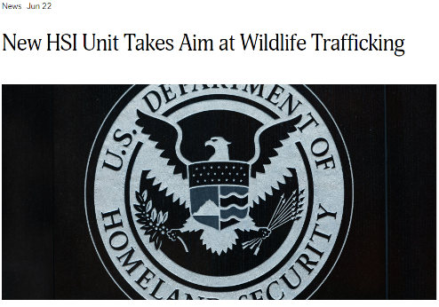

Enforcement

Slide 8

Call to action
Greater coordination among consumer countries to stop being an economic driver for illegal timber and wood products and promote legal trade.

