Slide 1
FROM INTELLIGENCE-FED TO INTELLIGENCE-LED
(… and Beyond)
Sheldon Jordan
Conservation Management and Environmental Enforcement Consultant

Slide 2
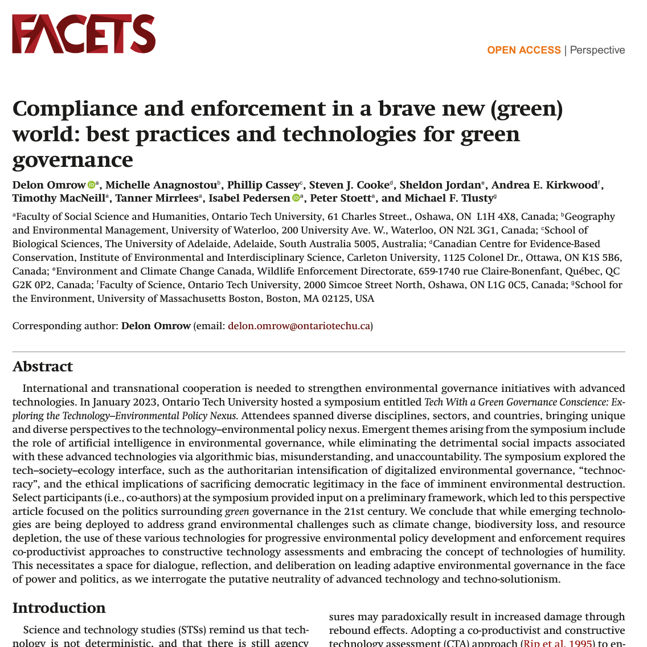
AI & Green Governance ?
“We have the technologies and knowledge to build a sustainable future, but there is one final challenge: how do we get the best information into the policy makers’ hands at the right time, and ensure that this information is actually acted upon and implemented? (…)
“While technology promises wonderful solutions to the problems of our time, it is not in itself or by itself a fix to challenges of green governance.”
https://doi.org/10.1139/facets-2023-0105

Slide 3
How it Should Work
Criminal Environment
Interpret
Impact
Crime
Intelligence
Analysis
Decision Maker
Influence
Ratcliffe, 2016

Slide 4
Intelligence Maturity
 | Standard Model | Initiating | Growing | Integrated – Intel Led
Culture | Reactive to complaints | Looking to improve (or told to) | Compliance and enforcement functions gaining confidence | Critical beyond compliance and enforcement into regulatory and policy functions.
Capability | Information analysis is self-led | Informs low-level decisions ad hoc | Increasing professional incumbents | Specialisation within analysis to inform multiple audiences.
Structure | No dedicated resources, but some analysis happening ad hoc. | Limited dedicated resources – officer(s) and analyst(s) | Transitioning from dispersed to centralised with knowledgeable leadership | Stand-alone responsibility structure (line and staff management)
Strategy | Nice to have. | Mostly tactical / investigative support. Limited strategic focused on very small areas (commodities, activities) | Some intelligence informing strategic planning / priorities. Occasionally informing policy development. | Predictably tasked / informing regulatory development and enforcement functions
Evidence- Based
Verify / validate, measure impact and improve
Internal / external risk assessment informs operational / policy responses.
Formal or informal structures; partnerships with academia / specialized stakeholders
Organisation is accountable for demonstrating best use of resources
…and beyond
Based on UK College of Policing / Evidence-Based Policing Maturity Model

Slide 5
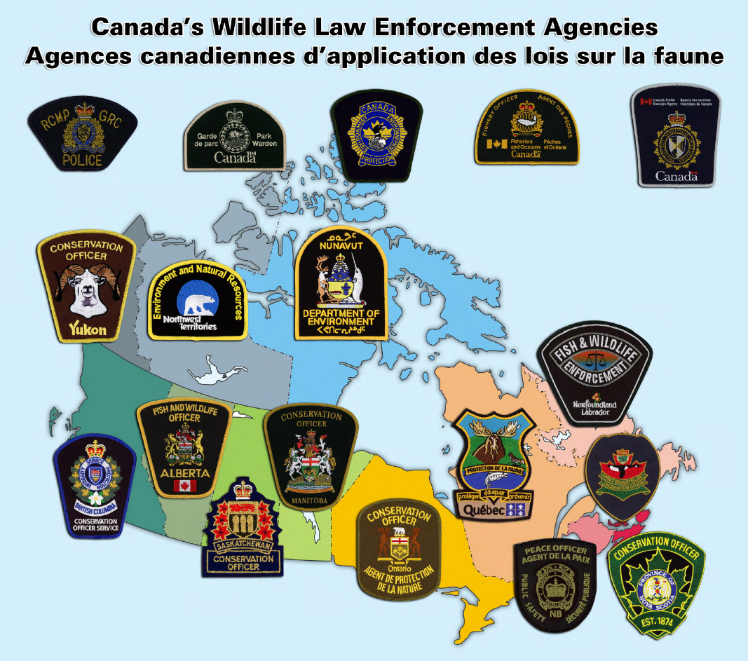
How many could use an Intel-Led approach?

Slide 6
From Fed to Led
Criminal Environment
Whole of Organization Approach (and beyond)
Develop your plan
Deliver tailored training by function and level
Decision Makers are Key
All Practitioners have a role to learn and play
Lessons Learned (Do More Of):
Engage Regulatory Clients and Policy Makers
Implement Processes and Accountability Mechanisms
Sharpen the Saw*
(*apologies to Stephen Covey)
Interpret
Impact
Intent
(Inform,
Include)
Crime
Intelligence
Analysis
Decision Maker
Influence
Tailored Training
Process / Accountability
Ratcliffe, 2016 modified

Slide 7
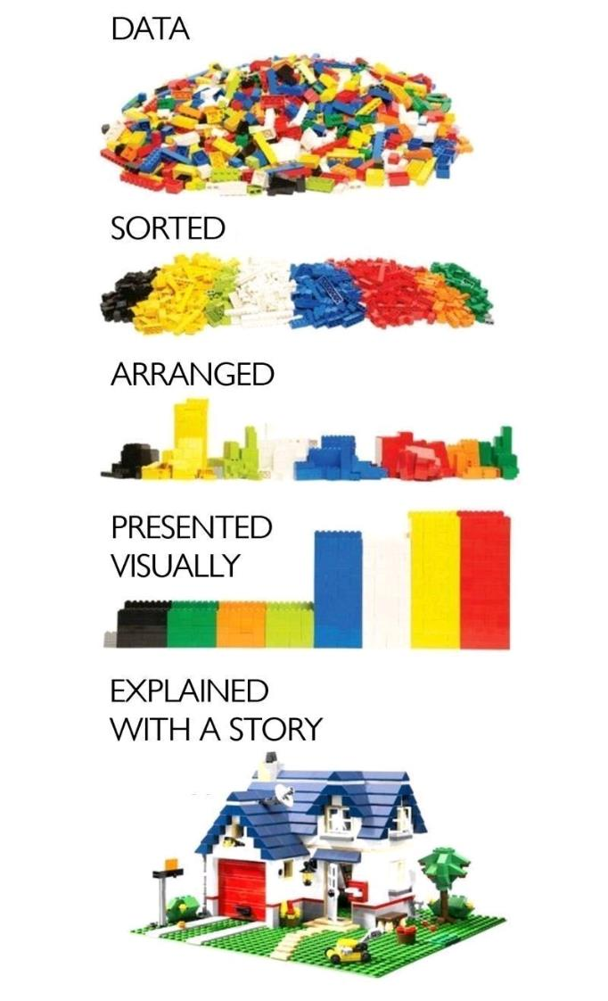
Lead with Intelligence
Cultivate and use Intelligence systematically – from the top – in regulations and enforcement.
Building an Intelligence-Led culture pays results to those who take the time and effort.
Implement processes and accountabilities to maximise and protect your investment.
Image Source Unknown

