Slide 1
Outcome and impact reporting in environment protection regulation
Dr Su Wild-River, ACT Environment Protection Authority
Access Canberra, ACT Government
AELERT and INECE Global summit
Thursday 7 November 2024

Slide 2
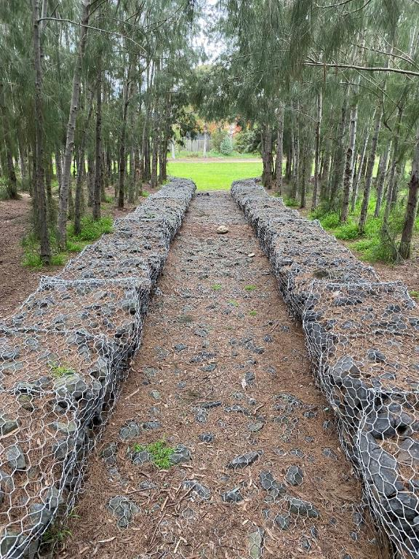
Overview
Goal
Definitions
Disclaimer
Examples
Tier 4 – Resource Efficiency
Tier 3 – Activities and Outputs
Tier 2 – Behavioural change
Tier 1 – Impacts and outcomes
Opportunities

Slide 3
Goal
Explore tiers of regulatory activities
Develop capacity to deliver and report on outcomes
Photo by Anastasia Shuraeva: https://www.pexels.com/photo/person-stepping-on-a-soccer-ball-9517918/

Slide 4
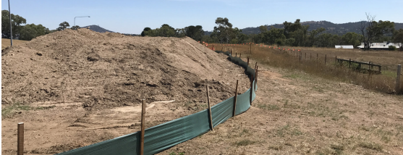
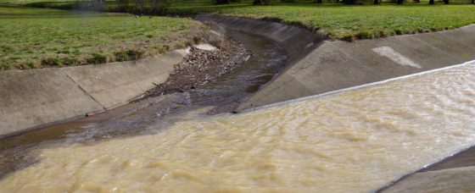
Definitions
$
EP
Act
Tier 4: Resource efficiency
Agency resources and authority
Regulated community’s resources,
Tier 3: Activities and outputs
Enforcement actions (numbers, seriousness, penalties etc),
Inspections (numbers, nature, findings etc),
Education, outreach, collaborative partnerships,
Tier 2: Behavioural change
Compliance and non-compliance,
Other changes such as adoption of best practice and other risk reduction activities.
Tier 1:Impacts and outcomes
Environmental emissions, health effects, declines in injury and accident rates.
Tiers from Sparrow, M 2000. The Regulatory Craft: Controlling risks, solving problems and managing compliance.
Tiers from Sparrow, M 2000. The Regulatory Craft: Controlling risks, solving problems and managing compliance.

Slide 5
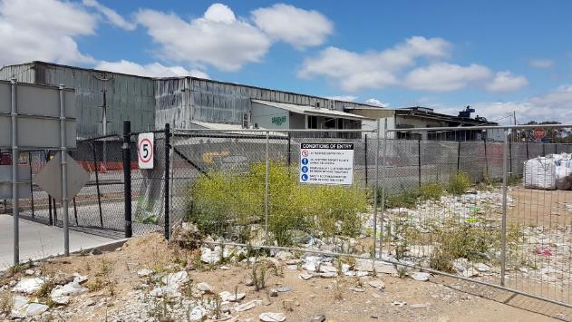
Disclaimer
Examples are excerpts from
broader legislation and
reports
Selected for:
Demonstration of the model
Compelling graphics
Do not represent:
The best or only examples, or
Full extent of agencies’ efforts or reporting

Slide 6
Tier 4 Resource efficiency
$
EP
Act
Agency resources and authority Regulated community’s resources State authority

Slide 7
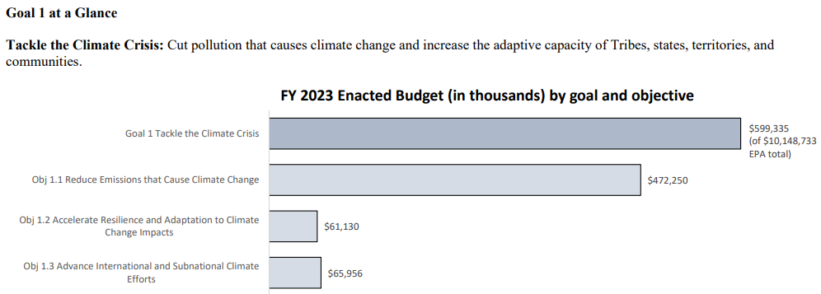
USA EPA Annual Performance Report 2023
Progress towards the 2022-2026 USA EPA Strategic plan.
Deliver programmatic and financial performance reports on an annual basis.
https://www.epa.gov/system/files/documents/2024-04/fy25-cj-15-program-performance.pd,
https://www.epa.gov/planandbudget/results f

Slide 8
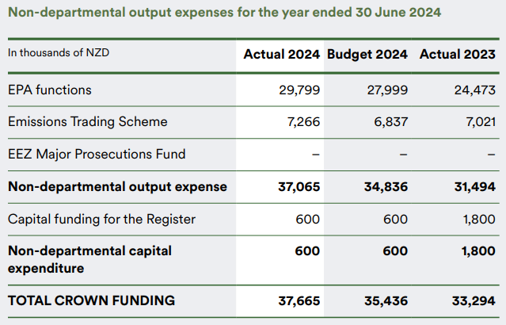
NZ Environment Protection Authority Act 2011
Establish an EP Authority and provide for its functions and operations.
https://www.epa.govt.nz/assets/RecordsAPI/EPA-Annual-Report-2024.pdf

Slide 9
Tier 3 Activities and outputs
Enforcement actions (numbers, seriousness, penalties etc), Inspections (numbers, nature, findings etc), Education, outreach, collaborative partnerships,

Slide 10
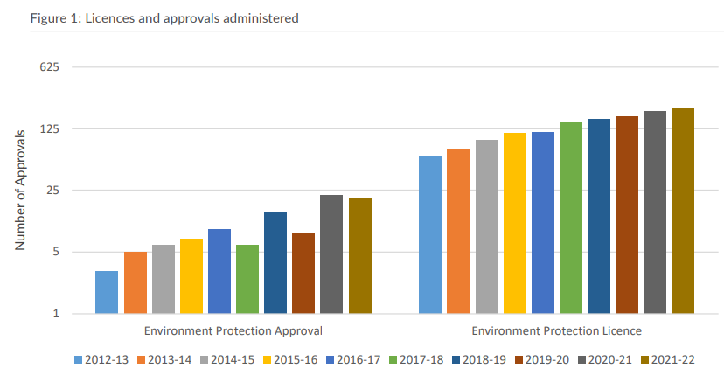
Northern Territory Authority Act 2012
Administer licences and approvals
https://ntepa.nt.gov.au/__data/assets/pdf_file/0004/1170274/ntepa-annual-report-2021-2022.PDF

Slide 11
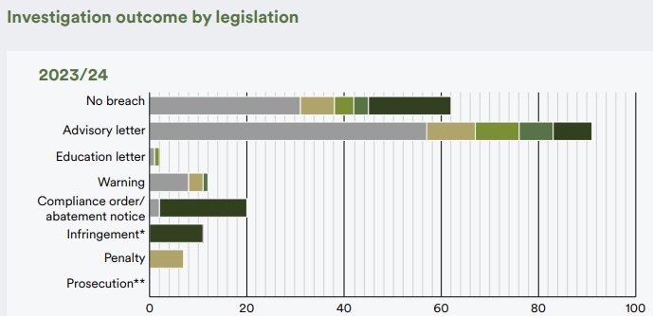
New Zealand Environmental Protection Authority
Regulate the use of chemicals and hazardous substances, manage rules for new organisms, regulate offshore activities, administer Emissions Trading Scheme.
Hazardous Substances and New Organisms Act 1996
Climate Change Response Act 2002
Exclusive Economic Zone Act 2012
Ozone Layer Protection Act 1996
Resource Management Act 1991
https://www.epa.govt.nz/assets/RecordsAPI/EPA-Annual-Report-2024.pdf

Slide 12
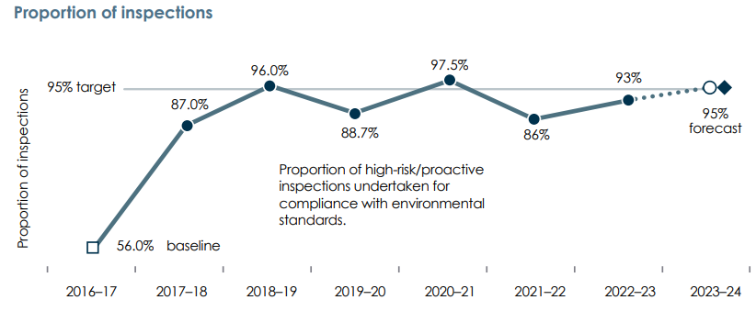
NSW Protection of the Environment Operations Act 1997
Reduce risks to human health and prevent the degradation of the environment by promoting pollution prevention and cleaner production.
https://www.epa.nsw.gov.au/-/media/epa/corporate-site/resources/about/23p4475-annual-report-2022-23.pdf

Slide 13
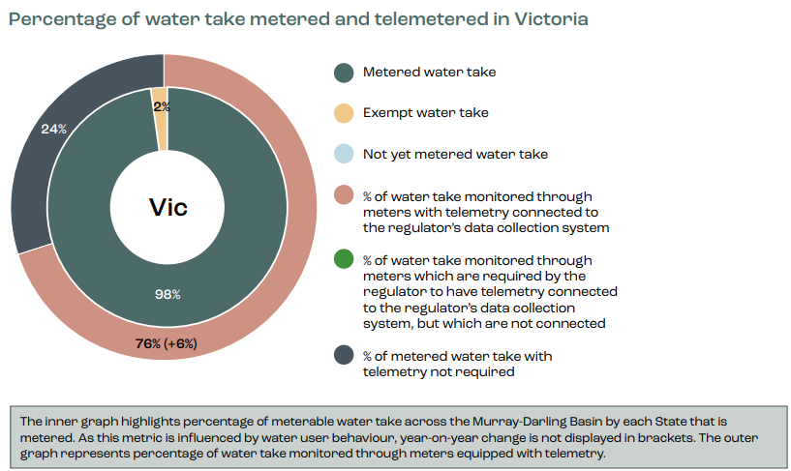
Australian Inspector-General of Water Compliance
Monitor and provide independent oversight of water compliance.
https://www.igwc.gov.au/sites/default/files/2024-04/murray-darling-basin-metering-report-card-2023.pdf

Slide 14
Tier 2 Behavioural change
Compliance and non-compliance, Other changes such as adoption of best practice and other risk reduction activities.

Slide 15
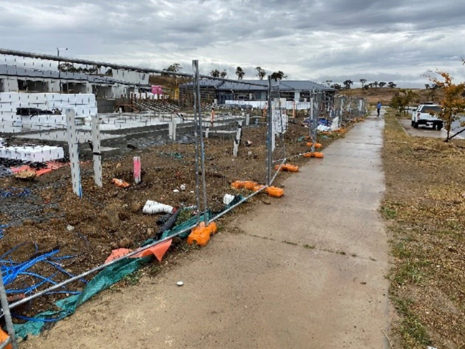
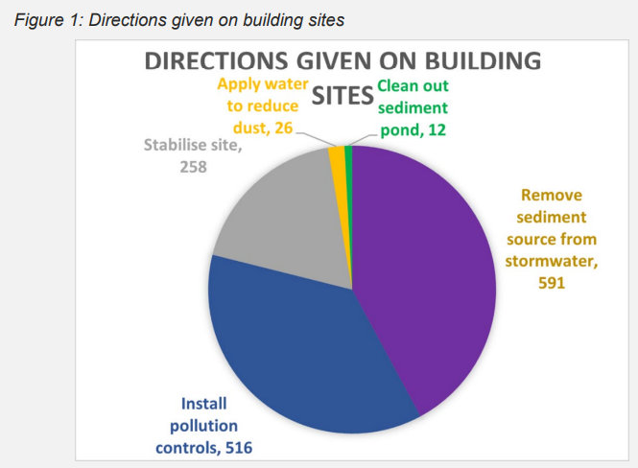
ACT EPA – Environment Protection Act 1997
Require people engaging in polluting activities to make progressive environmental improvements.
https://www.cmtedd.act.gov.au/__data/assets/pdf_file/0016/2301244/2022-23-CMTEDD-Annual-Report-Volume-1.pdf

Slide 16
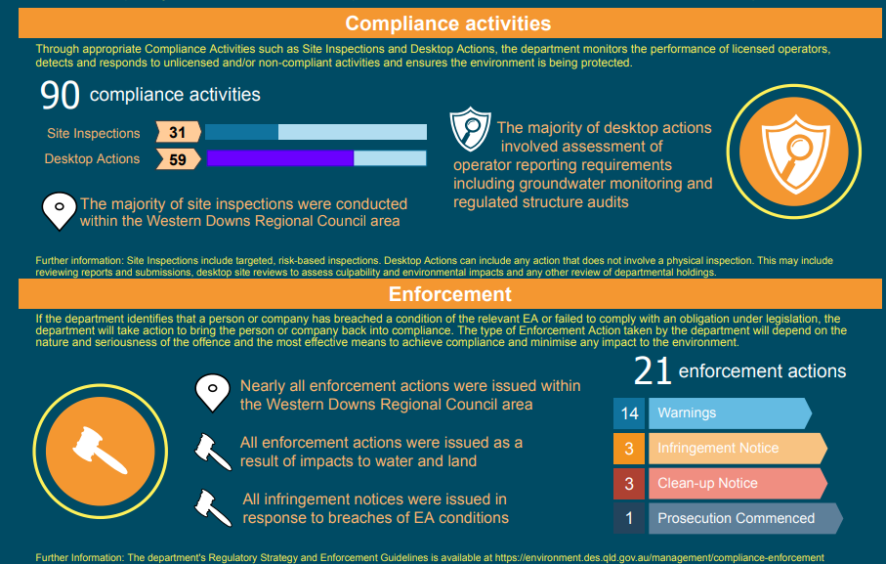
Qld Environment Protection Compliance and Enforcement
Educate about laws and how to comply, encourage compliance, monitor and respond to breaches of the legislation with consistent and proportionate enforcement action
https://environment.desi.qld.gov.au/__data/assets/pdf_file/0026/254654/coal-seam-gas-compliance-enforcement-report-2020-21.pdf, https://environment.desi.qld.gov.au/management/compliance-enforcement

Slide 17
Tier 1 Impacts and outcomes
Environmental emissions, health effects, declines in injury and accident rates.

Slide 18
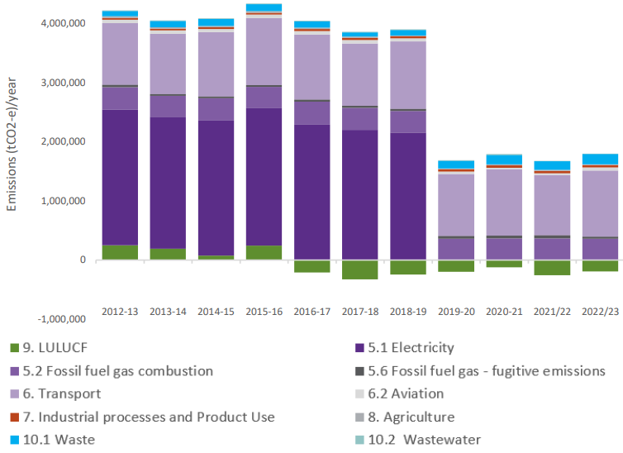
ACT Greenhouse Gas Emission Reduction
Emissions to be 50-60% less then 1990 by mid-2025
1990 = 3,041 ktCO₂e
2022-23 = 1,622 ktCO₂e
= 47% less than 1990 levels by mid-2023
https://www.climatechoices.act.gov.au/__data/assets/pdf_file/0003/2329824/ACT-Greenhouse-Gas-Inventory-Report-2022-23.pdf

Slide 19
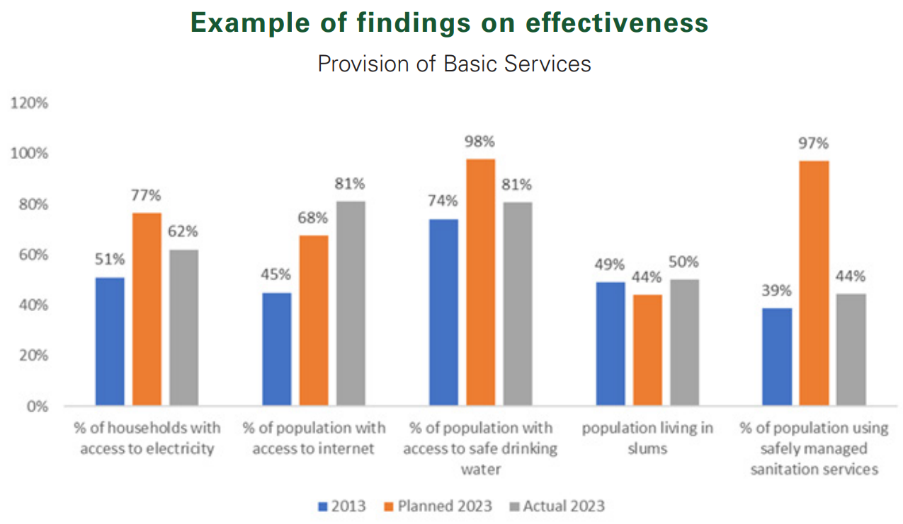
African Union Commission and African Union
Report on initiatives that embody the Union’s efforts and lie at the heart of its actions
https://portal.africa-union.org/DVD/Documents/DOC-AU-WD/EX%20CL%201505%20(XLIV)%20_E.pdf

Slide 20
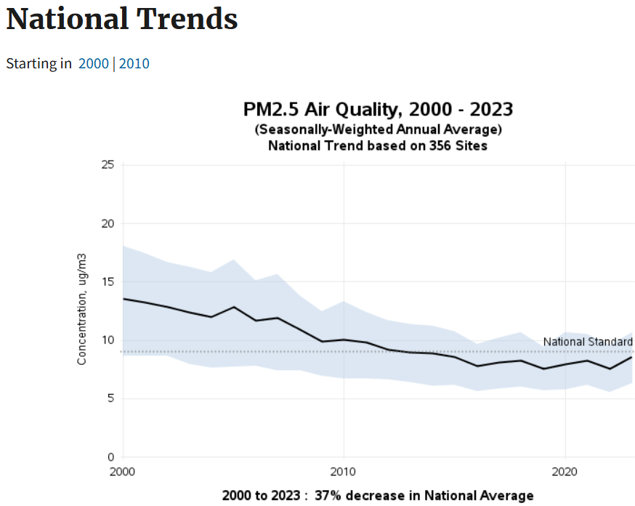
USA Clean Air Act 1970
Set and review national air quality standards for PM. Air quality monitors measure concentrations of PM throughout the country.
https://www.epa.gov/air-trends/particulate-matter-pm25-trends

Slide 21
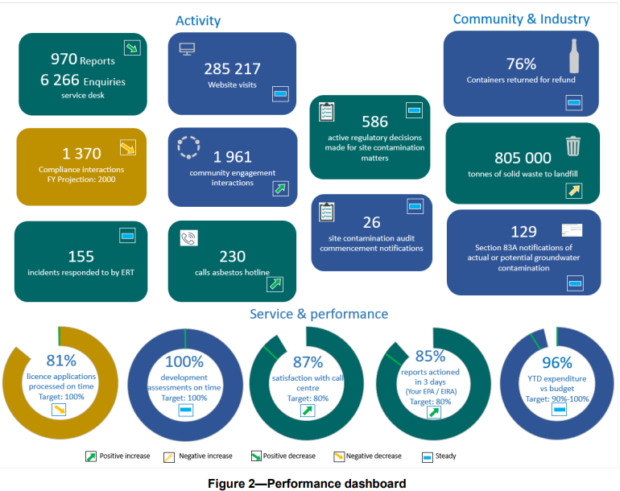
South Australia – EPA administration
Pursue sustainable practices that protect the environment and people’s health, safety and wellbeing, while also supporting economic growth.
Tier 3 – Activities and outputs
Tier 2 – Behavioural change
https://www.epa.sa.gov.au/files/15769_annualreport_2022-23.pdf
Tier 1 –Outcomes and impacts
Tier 4 – Resource efficiency

Slide 22
Opportunities

Slide 23
Opportunities
Apply the model
Be aware of what you are targeting and reporting,
Tier 4 – Resource efficiency,
Tier 3 – Activities and outputs,
Tier 2 – Behavioural change,
Tier 1 – Impacts and outcomes.
Increase outcome delivery and reporting
Ask how resources, activities, outputs and behaviour change drive outcomes,
Connect regulatory activities to outcomes, and
Report on the outcomes.

